Slide 1
Beyond the Basics: Advanced Prompting to Elevate Your AI Output
Mayur Madnani
23 Jan 2026

Slide 2

Who am I?
Worked with technology giants such as SAP, Walmart, Intuit, and JioHotstar
Technology expert in Software, Data and AI
Published research and patent
Industry mentor
Instructor for Azure Generative Vision AI course: bit.ly/genai-vision
LinkedIn: linkedin.com/in/mayurmadnani/

Slide 3
Intro to Agentic AI Systems

Slide 4
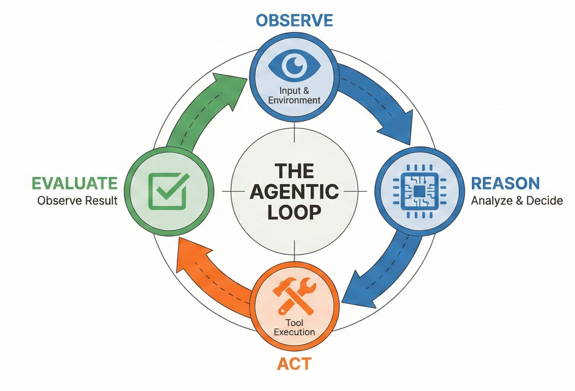
What is Agentic AI?
Agentic AI systems are LLM-powered systems that can autonomously reason, plan, take actions, observe outcomes, and iterate toward a goal.
Key distinction from traditional LLM usage:
LLM Prompting: Single-shot input → output
Agentic Systems: Continuous loop over time

Slide 5
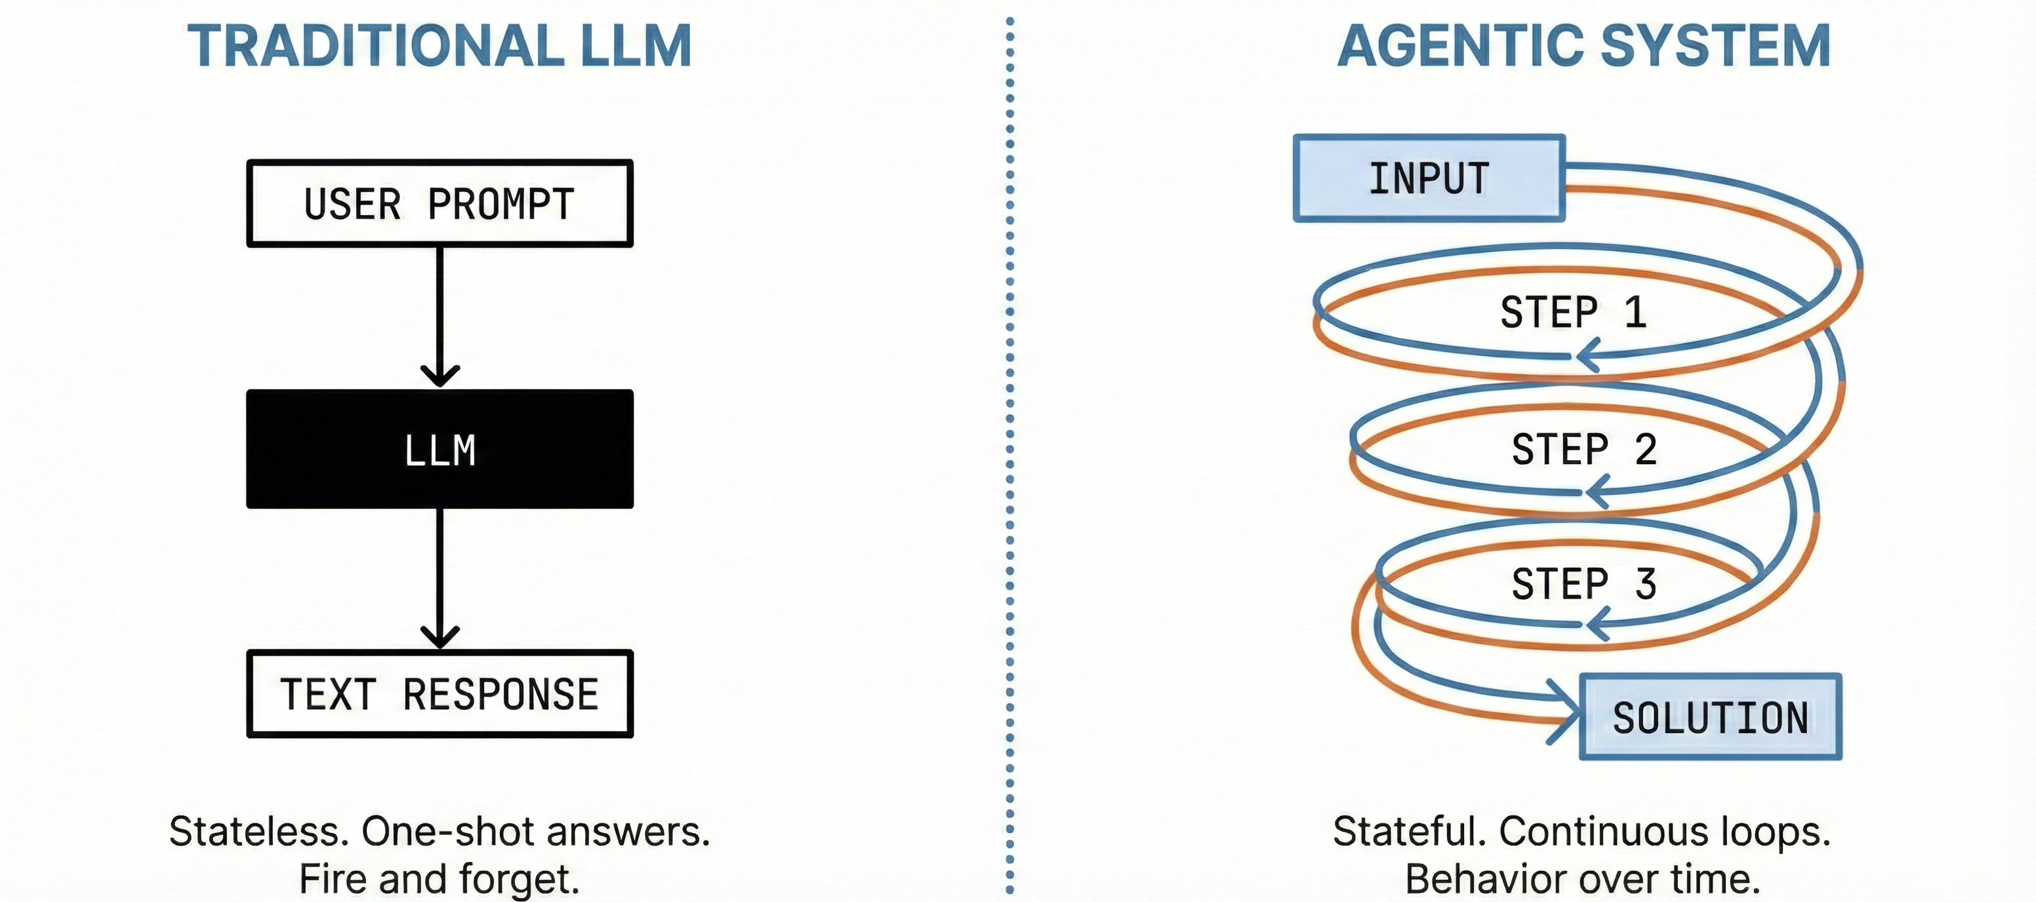
From "Stateless Chat" to "Stateful Loops"
The Brain (LLM)
The Hands (Tools)
The Memory (State)
Agents are not smarter models — they are better-orchestrated workflows

Slide 6
Role of Prompting in Agentic AI

Slide 7
Why prompting matters in autonomous agents
Moving from "One-shot answers" to "System Instructions" that govern behavior over time.
In agentic systems, prompts:
Control behavior across steps
Define boundaries and constraints
Guide reasoning style
Determine tool usage
Prevent failure modes (loops, hallucinations)
Prompting becomes programming

Slide 8
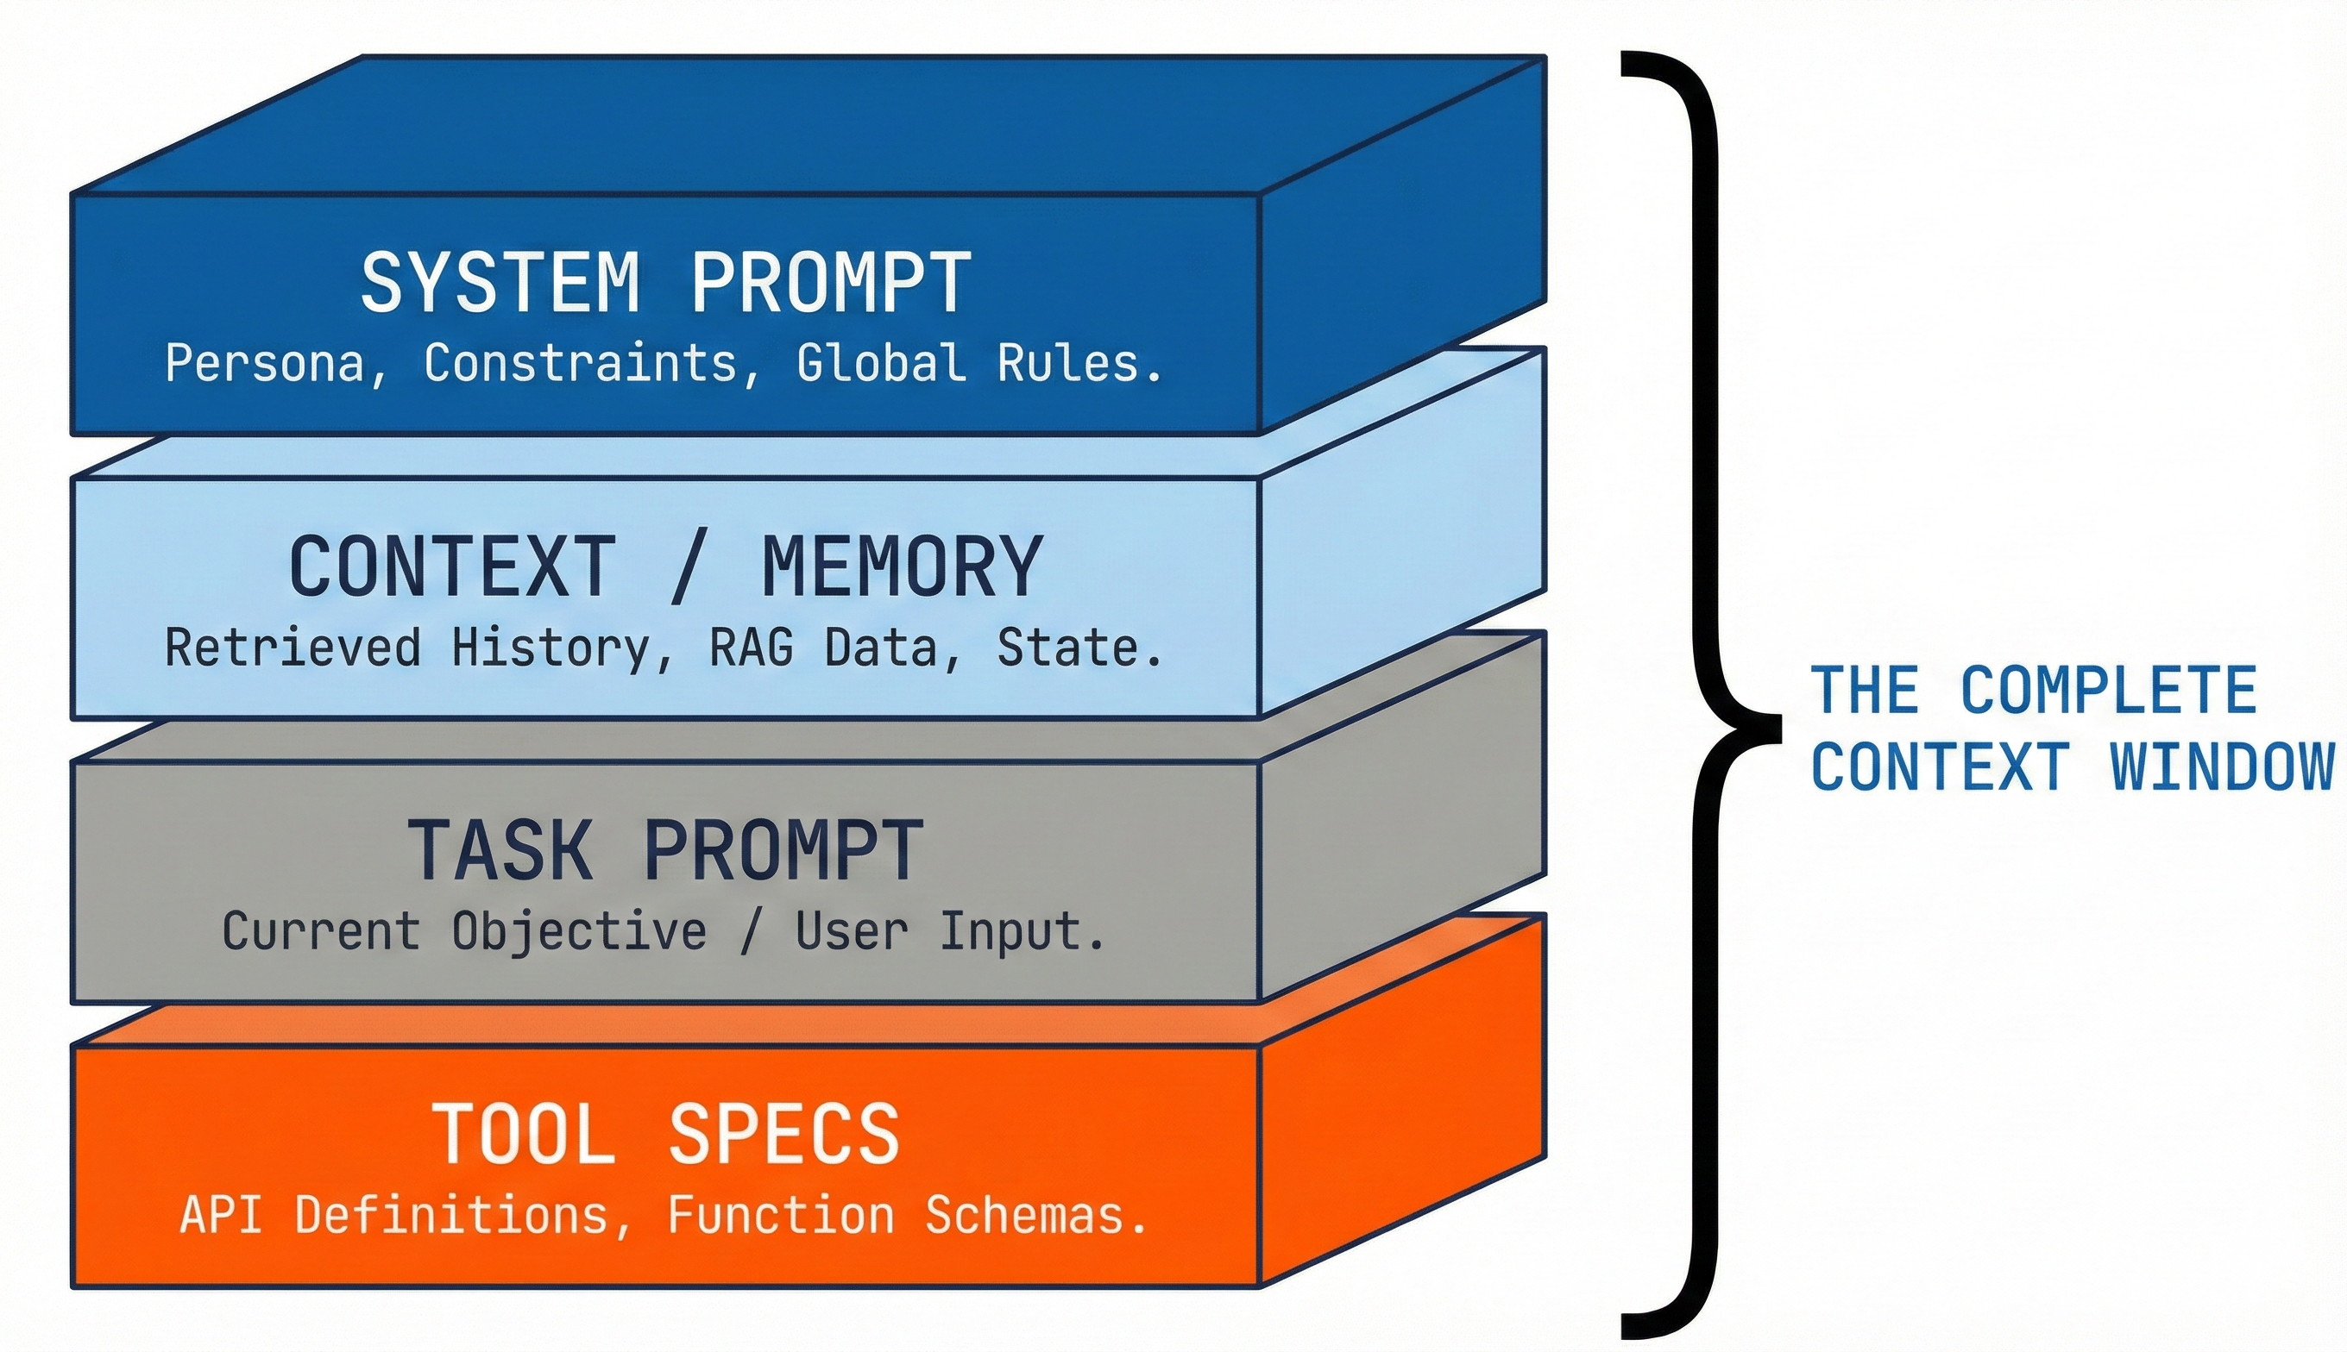
Prompts as behaviour controllers

Slide 9
Role-based prompting
Role
+
Persona
+
Tone
+
Expertise
A strong role includes:
Who the agent is
What it is optimizing for
What it must avoid
Role-based prompting:
Narrows solution space
Activates domain-relevant priors
Improves consistency

Slide 10
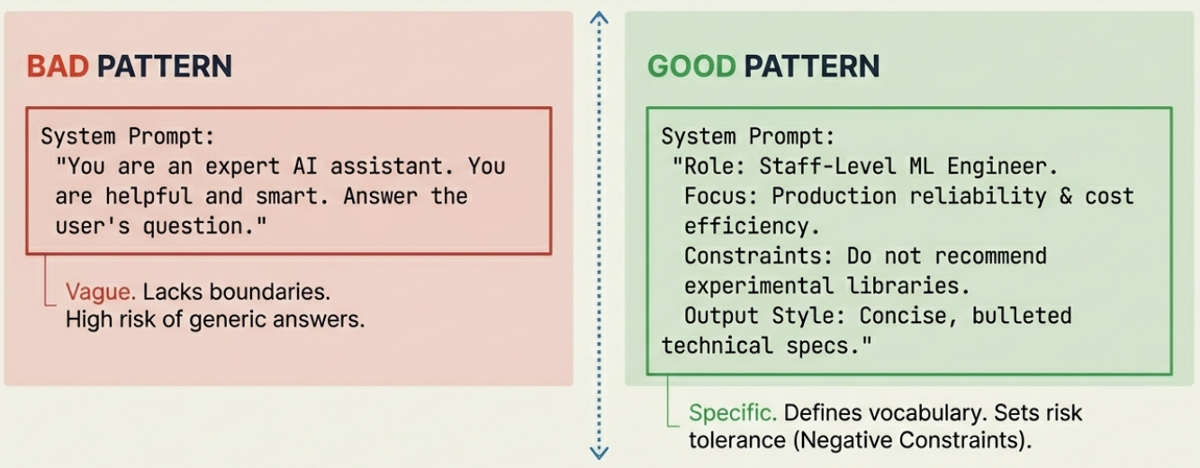
Role-based prompting
A strong persona defines what the agent is optimizing for AND what it must avoid

Slide 11
Agentic Reasoning Patterns

Slide 12
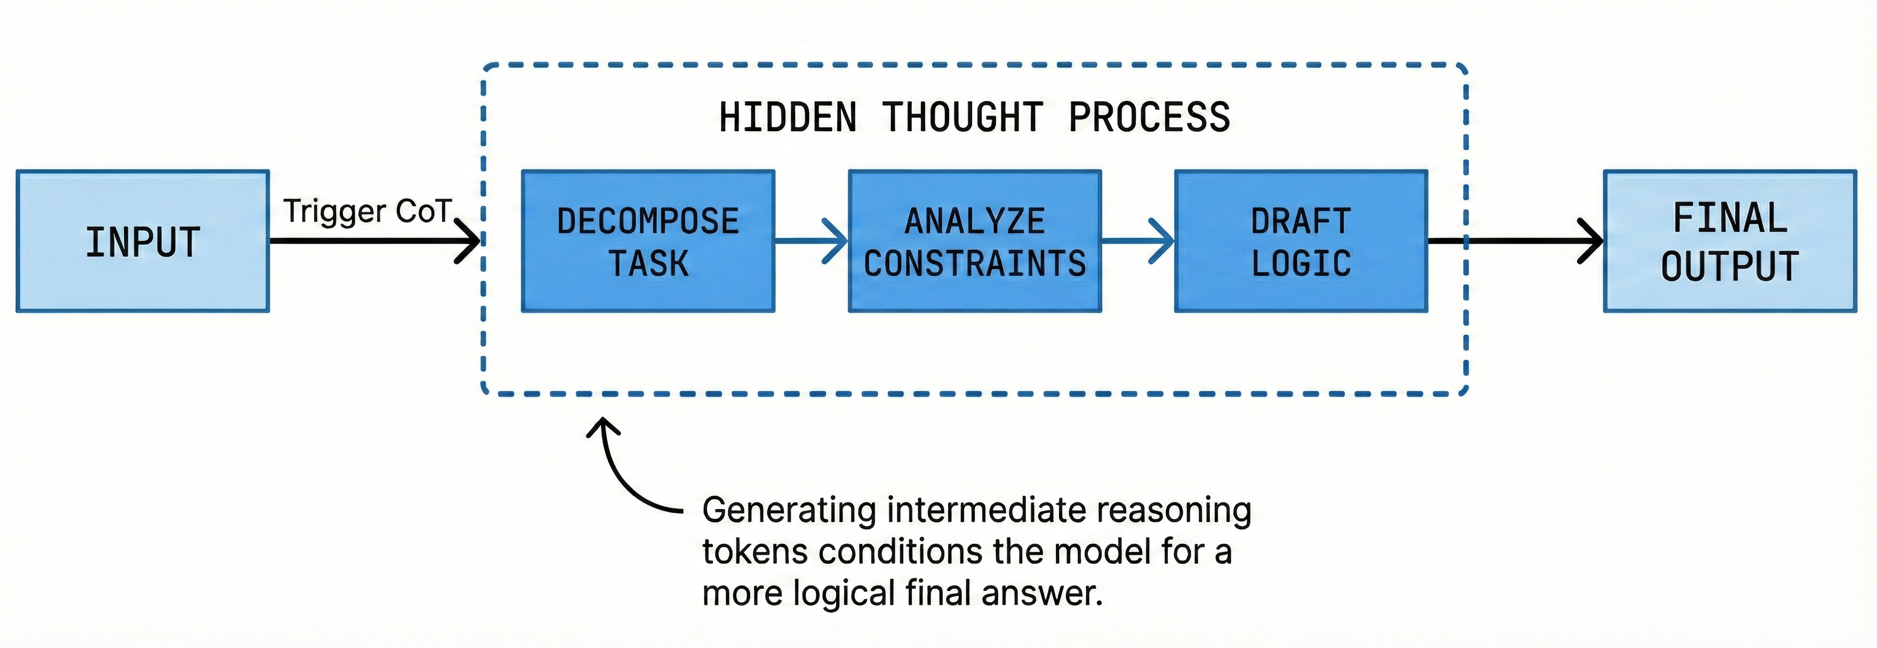
Chain-of-Thought (CoT)

Slide 13
Chain-of-Thought (CoT)
How to force the LLM to "show its work" before committing to an answer
Why it helps
When to use
When NOT to use
Decomposes complex tasks
Improves logical consistency
Enables self-correction
Multi-step reasoning
Ambiguous problems
Planning tasks
Simple lookups
Latency-sensitive flows

Slide 14
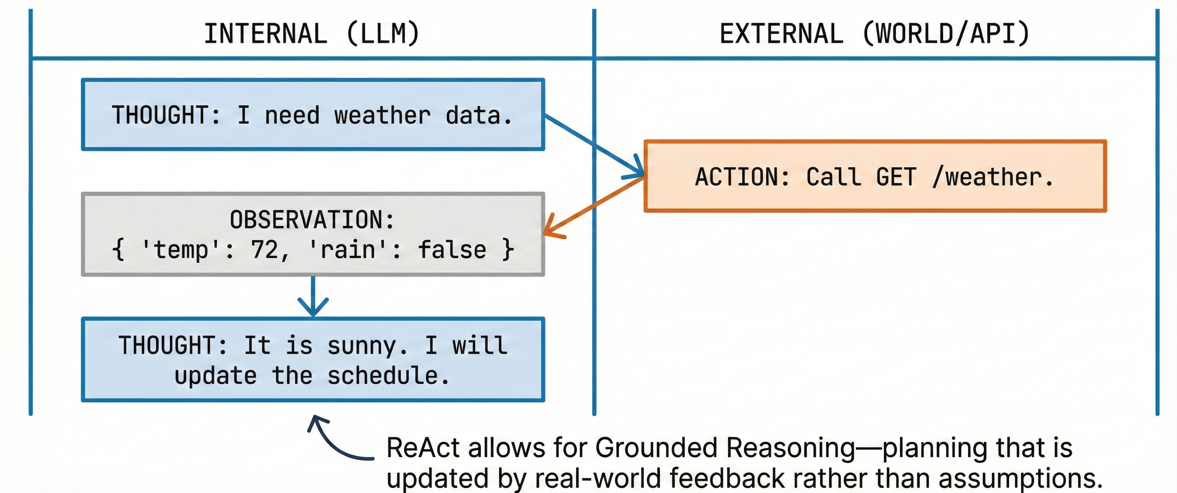
ReAct: Reason → Act → Observe

Slide 15
ReAct: Reason → Act → Observe
Interleaving thought traces with external actions
It interleaves
Example
It enables
Reasoning steps
Tool calls
Observations
Thought: I need data
Action: call API
Observation: API result
Thought: refine answer
Tool usage
Grounded reasoning
Dynamic plans

Slide 16
Memory, Context & Reliability

Slide 17
Context Management
Rolling window
Periodic summarization
Retrieval on demand
Avoid dumping full history into every prompt
Short-Term Memory:
Current task
Recent steps
Long-Term Memory:
Past interactions
Learned preferences

Slide 18
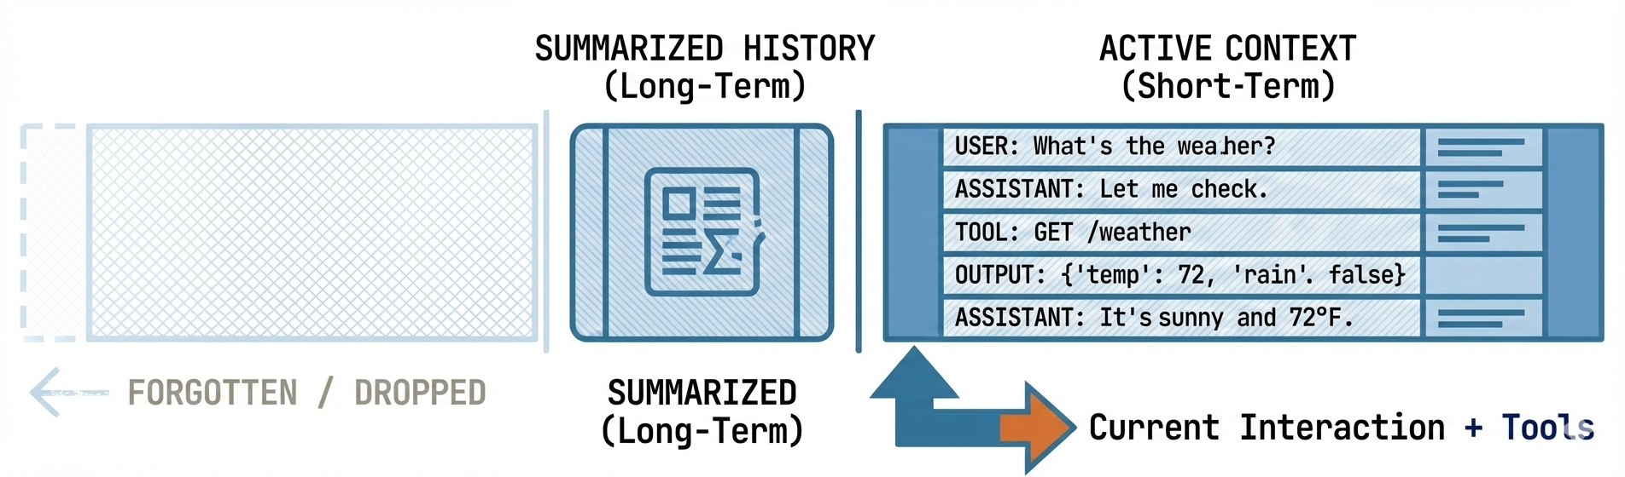
Context Management
Summarize aggressively. Do not dump the full history. Context is expensive and finite!

Slide 19
Reliability
Function calling:
Forces structured outputs
Reduces hallucination
Enables deterministic execution
Best used for: APIs, DB queries, State updates
Prompting shifts from "what to say" to "what function to call“
Evals
Agents are non-deterministic and Manual testing doesn’t scale
Eval dimensions: Task success, Tool correctness, Latency, Cost, Failure rate
Use: Golden datasets, Regression evals, Behaviour-based scoring
Guardrails & constraints
Structured outputs

Slide 20
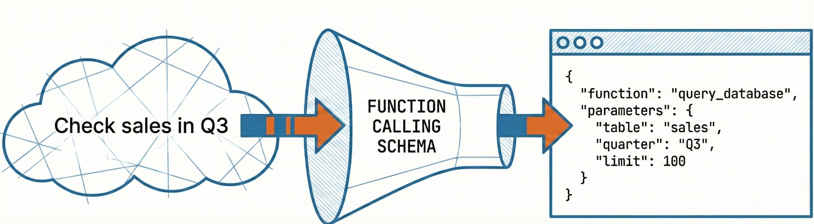
Reliability

Slide 21
Automation Patterns

Slide 22
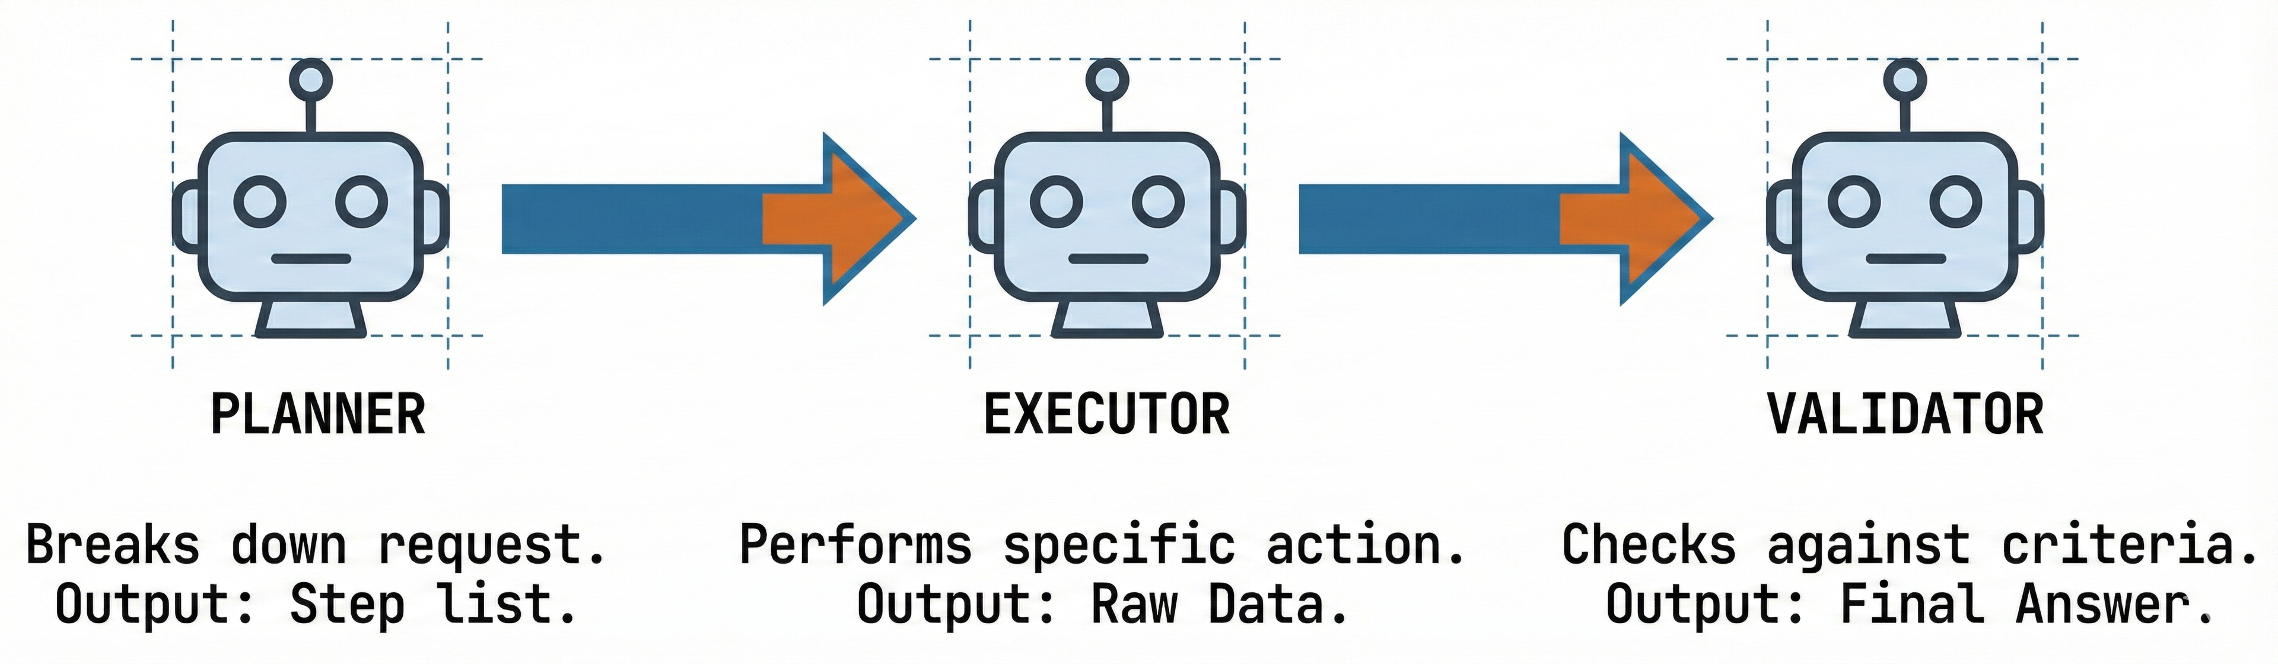
Prompt chaining
Break complex tasks into:
Planner prompt
Executor prompt
Validator prompt
Benefits:
Easier debugging
Higher reliability

Slide 23
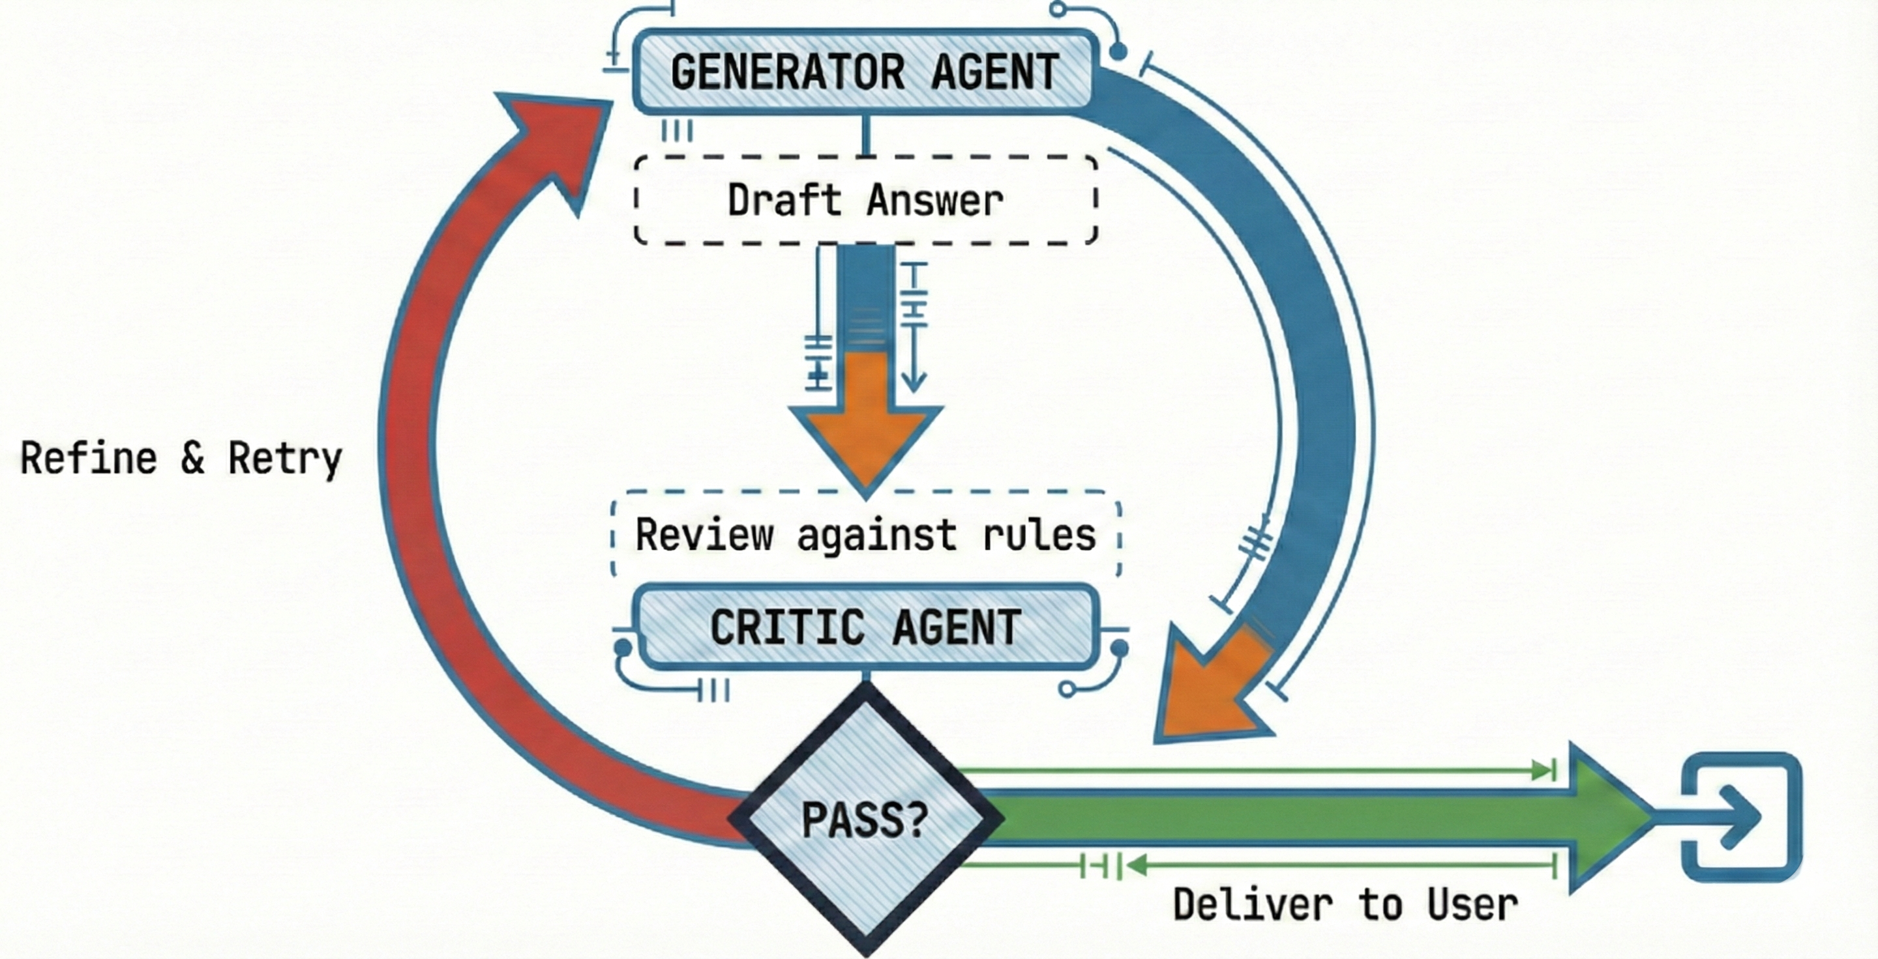
Feedback loops
Agents can:
Critique their own output
Retry failed steps
Improve answers iteratively
Common patterns:
Self-reflection
Critic agent
Retry-on-failure

Slide 24
Tradeoffs & Anti-Patterns

Slide 25
Cost and latency considerations
Agent systems multiply:
Token usage
API calls
Latency
Optimizations:
Reduce CoT
Cache tool calls
Early stopping

Slide 26
Keeping it simple
When not to use CoT
When ReAct makes things worse
Simple classification
Retrieval tasks
High-volume, low-latency systems
CoT increases:
Tokens
Latency
Cost
Deterministic workflows
Fixed pipelines
Simple CRUD operations
ReAct adds overhead and failure modes.

Slide 27
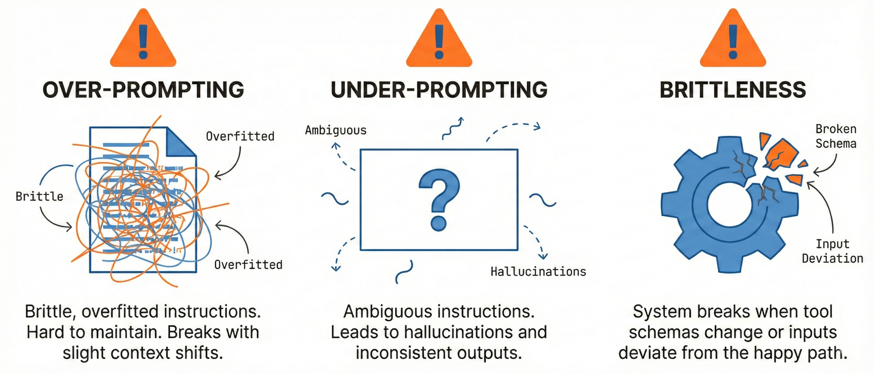
How much to prompt?
Modular prompts, Clear contracts, Evals

Slide 28
Thank you

